Slide 1
A Proof of Turing completeness in Bitcoin Script
Dr. Craig S. Wright
February 2019
Notes:
1

Slide 2
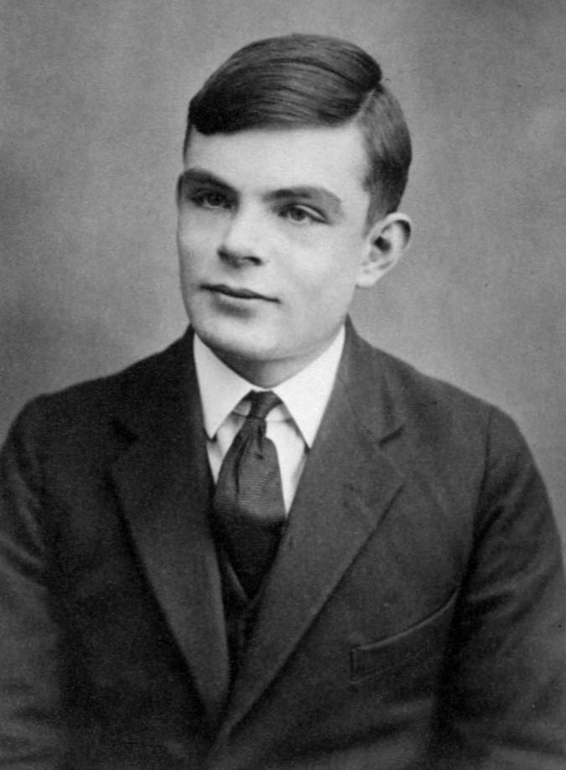
Introduction
A programming language in Bitcoin script that is equivalent to the Turing machine family
Consider system with an alphabet, $C=\{c_{0},c_{1}, …,c_{n}\}$ with $n≥1$…
1 million megabyte blocks can be viable

Slide 3
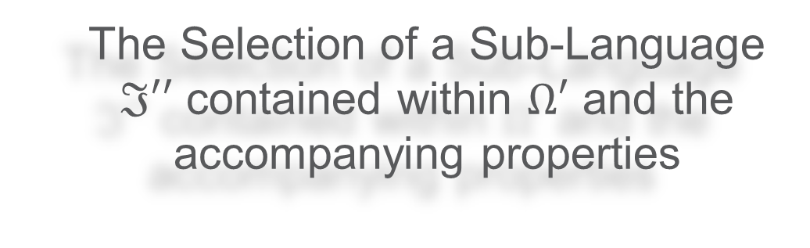
A definition of ℑ′′
The Selection of a Sub-Language $ℑ′′$ contained within $Ω′$ and the accompanying properties
1 million megabyte blocks can be viable

Slide 4
A definition of ℑ′′
Condition 1
For each occurrence of there will exist at most a single occurrence of or its alternative .
1 million megabyte blocks can be viable

Slide 5

A definition of ℑ′′
Condition 2
The number of jumps within our language is even and may be defined as jumps that is part of a set that is partition of all within pairs . These pairs are defined in a manner such that the following pairs of words can be considered to occur within P:

Slide 6
A definition of ℑ′′
Condition 3
For any two values of j that are distinct such that which we will define as q and r, we can consider P in the following geometrical intervals:
All such intervals will lie within the following relation:
1 million megabyte blocks can be viable

Slide 7
A definition of ℑ′′
Condition 4 - Right Monotony
Where then we can also say that for every word.
Set of the initial configurations with the property that all other configurations are defined for each machine .
1 million megabyte blocks can be viable

Slide 8
Condition 5 - Invertibility
A definition of ℑ′′
We can extend right monotony if we add the following:
Z is a word over
then we can also say that a further word exists over such that it is necessary for:
And of course, using the identity function we can also say that
1 million megabyte blocks can be viable

Slide 9

Computing a partial recursive function within ℑ′′
A program computes the function of variables in the event that by denoting through the use of the words over C that correspond respectively to the values of and through the use of the word corresponding to the value of the function, we obtain:
in this equation the character is used to define the blank symbol .

Slide 10


Computing a partial recursive function within ℑ′′
We can obtain the set of partial recursive functions through an application against the basic functions a finite number of times against the schemas below [10].
Basic Functions: Zero function of m variables
Successor
Predecessor Undefined
selection function
Schemas:
1. Composition.
Where , are partial recursive and with
Defined as which is partial recursive.
2. Recursion.
Where , , , (consisting of a single variable) are partial recursive then is also partial recursive. We define as follows:

Slide 11
Conclusion
1. Dual stack
It is not clear to see that Bitcoin is Turing complete, but once the use of the stack commands is introduced to the repertoire, we see that Script is a Stack machine that consists of a Dual stack architecture.
1. Primary stack has a series of commands that are designed to manipulate the stack with a high degree of malleability
2. Alt stack allows for a pointer and counter function
2. Script Commands
1. such as OP_PICK and OP_ROLL provide a great deal of granularity and control of the stack at any depth.
2. combined with data Pop’d into and off of the Alt stack as a control, the ability to extend Bitcoin script becomes clear.
3. Extension
extend bitcoin within script using unrolled functions
link to predicate systems and an extended multi-script system
extend and develop using compilers

